Slide 1
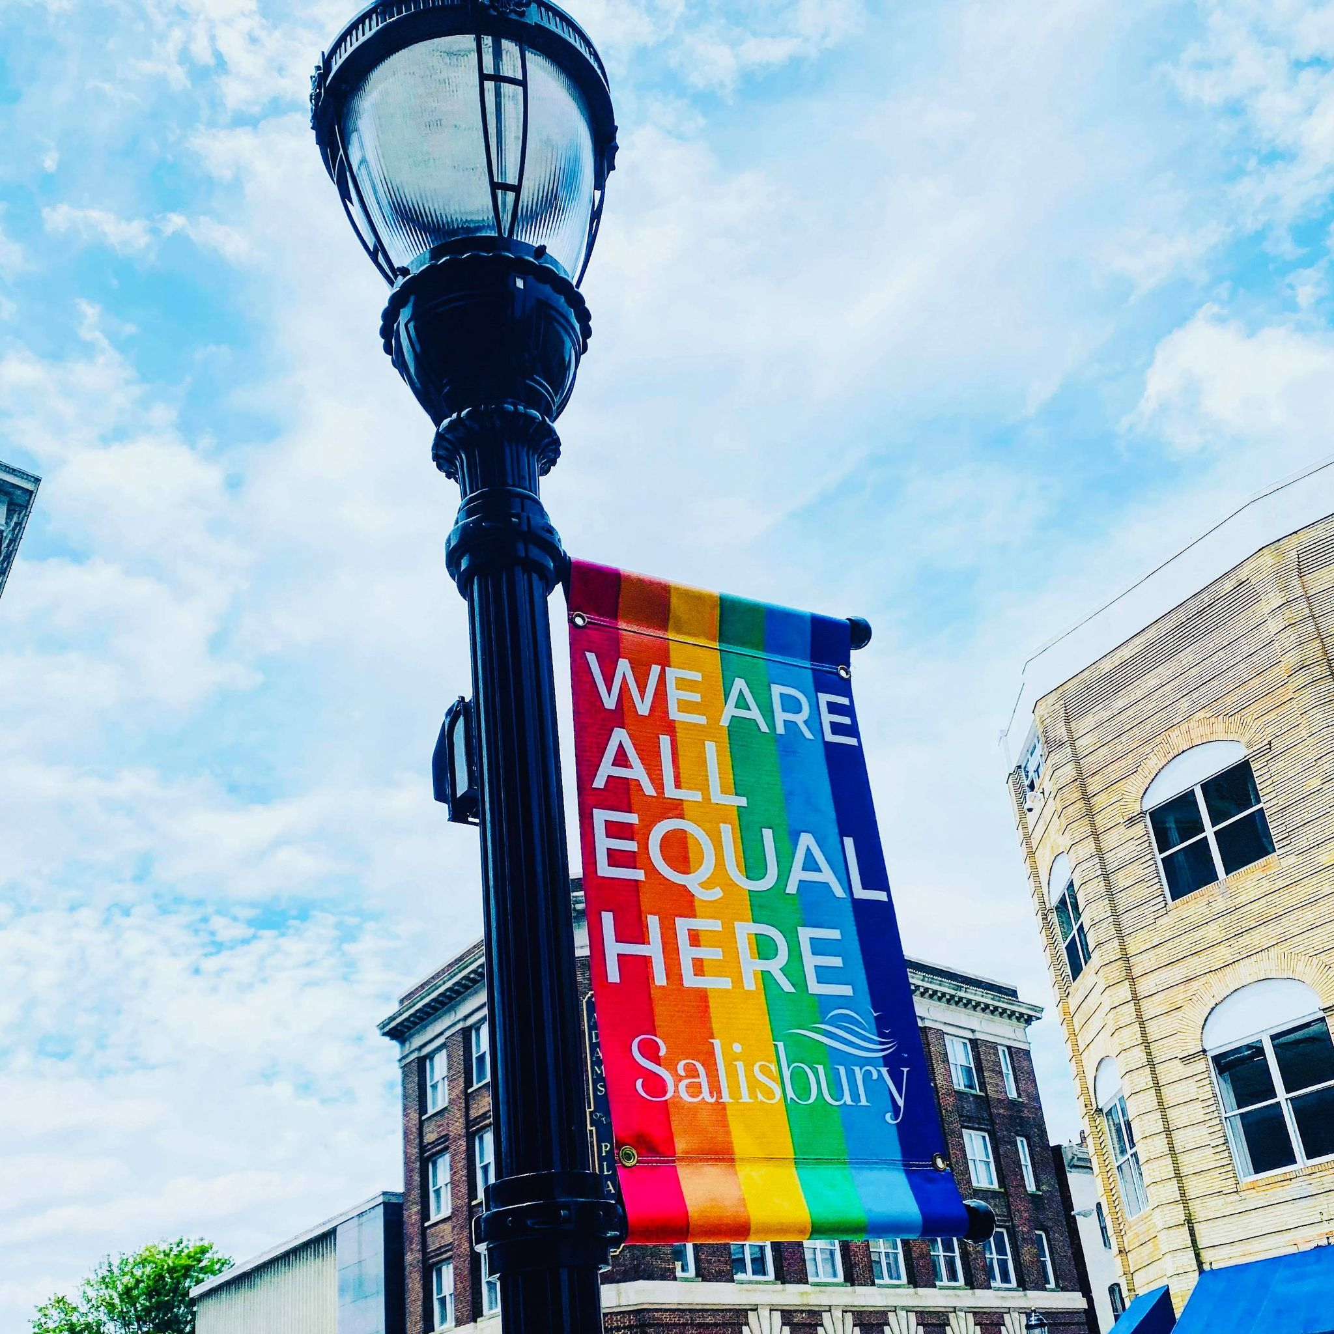

Delmarva LGBTQ+ Climate Survey
Eastern Shore of Maryland Only Filtered Responses
Prepared by Dr. Nicole Hollywood, Professor University of Maryland Eastern Shore and President of PFLAG Salisbury

Slide 2
Q2: What is your age?
Answered: 187 Skipped: 1

Slide 3
Q2: What is your age?
Answered: 187 Skipped: 1
ANSWER CHOICES | RESPONSES
18 to 24 | 16.04% | 30
25 to 34 | 29.41% | 55
35 to 44 | 22.46% | 42
45 to 54 | 16.04% | 30
55 to 64 | 11.23% | 21
65 to 74 | 4.28% | 8
75 or older | 0.53% | 1
TOTAL |  | 187

Slide 4
Q3: What best describes your sexual orientation?
Answered: 188 Skipped: 0

Slide 5
Q3: What best describes your sexual orientation?
Answered: 188 Skipped: 0
ANSWER CHOICES | RESPONSES
Asexual | 4.79% | 9
Bisexual | 21.28% | 40
Gay | 19.15% | 36
Heterosexual or straight | 9.04% | 17
Lesbian | 23.94% | 45
Pansexual/Polysexual | 17.02% | 32
Questioning | 2.13% | 4
None of the above, accurately reflect my sexuality | 2.66% | 5
TOTAL |  | 188

Slide 6
Q4: What best describes your gender identity?
Answered: 188 Skipped: 0

Slide 7
Q4: What best describes your gender identity?
Answered: 188 Skipped: 0
ANSWER CHOICES | RESPONSES
Female | 58.51% | 110
Male | 22.34% | 42
Non-Binary/agender/gender fluid | 17.02% | 32
Intersex | 0% | 0
None of the options listed reflect my gender identity | 2.13% | 4
TOTAL |  | 188

Slide 8
Q5: Do you personally identify as a transgender or as a gender non conforming person?
Answered: 188 Skipped: 0

Slide 9
Q5: Do you personally identify as a transgender or as a gender non conforming person?
Answered: 188 Skipped: 0
ANSWER CHOICES | RESPONSES
Yes | 28.19% | 53
No | 71.81% | 135
TOTAL |  | 188

Slide 10
Q6: Which race/ethnicity best describes you? (Please choose only one.)
Answered: 188 Skipped: 0

Slide 11
Q6: Which race/ethnicity best describes you? (Please choose only one.)
Answered: 188 Skipped: 0
ANSWER CHOICES | RESPONSES
American Indian or Alaskan Native | 0% | 0
Asian / Pacific Islander | 1.06% | 2
Black or African American | 8.51% | 16
Hispanic | 3.72% | 7
White / Caucasian | 79.79% | 150
Multiple ethnicity / Other (please specify) | 6.91% | 13
TOTAL |  | 188

Slide 12
Q7: Which of the following categories best describes your employment status?
Answered: 188 Skipped: 0

Slide 13
Q7: Which of the following categories best describes your employment status?
Answered: 188 Skipped: 0
ANSWER CHOICES | RESPONSES
Employed, working full-time | 61.17% | 115
Employed, working part-time | 12.23% | 23
Not employed, looking for work | 4.26% | 8
Not employed, NOT looking for work | 4.79% | 9
Retired | 3.72% | 7
Disabled, not able to work | 4.26% | 8
Student | 9.57% | 18
TOTAL |  | 188

Slide 14
Q8: What is the highest level of education you have completed?
Answered: 184 Skipped: 4

Slide 15
Q8: What is the highest level of education you have completed?
Answered: 184 Skipped: 4
ANSWER CHOICES | RESPONSES
Did not graduate from high school | 0% | 0
GED | 0.54% | 1
Graduated from high school | 10.33% | 19
Some College or Trade School | 23.37% | 43
Associates Degree | 10.87% | 20
Bachelors Degree | 26.63% | 49
Masters Degree | 20.11% | 37
Professional Graduate Degree | 4.89% | 9
Doctorate | 3.26% | 6
TOTAL |  | 184

Slide 16
Q9: Do you rent or own the place where you live?
Answered: 188 Skipped: 0

Slide 17
Q9: Do you rent or own the place where you live?
Answered: 188 Skipped: 0
ANSWER CHOICES | RESPONSES
Own | 53.19% | 100
Rent | 39.36% | 74
Neither (please specify) | 7.45% | 14
TOTAL |  | 188

Slide 18
Q10: In what county do you live?
Answered: 188 Skipped: 0
ANSWER CHOICES | RESPONSES
Wicomico | 70.21% | 132
Somerset | 8.51% | 16
Worcester | 12.23% | 23
Talbot | 3.72% | 7
Caroline | 1.60% | 3
Queen Anne"s | 0% | 0
Kent County MD | 1.06% | 2
Sussex County DE | 0.53% | 1
Kent | 0% | 0
Dorcester | 3.72% | 7
Other (please specify) | 0% | 0
TOTAL |  | 191

Slide 19
Q11: Are there any children currently living in your home?
Answered: 188 Skipped: 0

Slide 20
Q11: Are there any children currently living in your home?
Answered: 188 Skipped: 0
ANSWER CHOICES | RESPONSES
Yes | 33.51% | 63
No | 66.49% | 125
TOTAL |  | 188

Slide 21
Q12: How inclusive would you rank the community where you reside for LGBTQIA+ people
Answered: 188 Skipped: 0

Slide 22
Q13: Please, express your level of satisfaction with each of the following from extremely satisfied to extremely unsatisfied. If a question does not apply to you, select NA for not applicable.
Answered: 188 Skipped: 0
 | EXTREMELY DISSATISFIED | DISSATISFIED | NEITHER SATISFIED OR DISSATISFIED | SATISFIED | EXTREMELY SATISFIED | N/A | TOTAL | WEIGHTED AVERAGE
Experiences with local government | 6.38% 12 | 21.81% 41 | 31.91% 60 | 25.00% 47 | 3.72% 7 | 11.17% 21 | 188 | 2.98
Access to public services (examples- mail, libraries, social services, parks, transportation) | 3.72% 7 | 19.68% 37 | 16.49% 31 | 46.81% 88 | 11.17% 21 | 2.13% 4 | 188 | 3.43
Community resources for LGBTQIA+ individuals | 11.70% 22 | 27.66% 52 | 34.57% 65 | 20.74% 39 | 2.13% 4 | 3.19% 6 | 188 | 2.73
Safety for LGBTQIA+ people in your community | 8.51% 16 | 27.13% 51 | 38.83% 73 | 22.87% 43 | 1.60% 3 | 1.06% 2 | 188 | 2.82
Support for LGBTQIA+ families | 8.51% 16 | 27.66% 52 | 30.32% 57 | 22.34% 42 | 2.66% 5 | 8.51% 16 | 188 | 2.81
Interaction with police | 10.64% 20 | 19.68% 37 | 34.04% 64 | 13.83% 26 | 2.66% 5 | 19.15% 36 | 188 | 2.73

Slide 23
Q13: Please, express your level of satisfaction with each of the following from extremely satisfied to extremely unsatisfied. If a question does not apply to you, select NA for not applicable.
Answered: 188 Skipped: 0
BASIC STATISTICS
 | Min | Max | Median | Mean | Standard Deviation
Experiences with local government | 1.00 | 5.00 | 3.00 | 2.98 | 0.99
Access to public services (examples- mail, libraries, social services, parks, transportation) | 1.00 | 5.00 | 4.00 | 3.43 | 1.05
Community resources for LGBTQIA+ individuals | 1.00 | 5.00 | 3.00 | 2.73 | 1.00
Safety for LGBTQIA+ people in your community | 1.00 | 5.00 | 3.00 | 2.82 | 0.94
Support for LGBTQIA+ families | 1.00 | 5.00 | 3.00 | 2.81 | 1.00
Interaction with police | 1.00 | 5.00 | 3.00 | 2.73 | 1.00

Slide 24
Q14: Please, express your level of agreement to each of the following statements from strongly agree to strongly disagree. If a statement does not apply to you, select not applicable.
 | STRONGLY DISAGREE | DISAGREE | NEUTRAL/UNDECIDED | AGREE | STRONGLY AGREE | N/A OR UNKNOWN | TOTAL | WEIGHTED AVERAGE
There are adequate supports for LGBTQIA+ people | 11.70% 22 | 35.64% 67 | 28.72% 54 | 18.09% 34 | 1.60% 3 | 4.26% 8 | 188 | 2.61
There are adequate supports for parents of LGBTQIA+ kids | 13.90% 26 | 29.41% 55 | 21.39% 40 | 16.58% 31 | 2.14% 4 | 16.58% 31 | 187 | 2.56
There are adequate supports for LGBTQIA+ elders i | 17.55% 33 | 33.51% 63 | 22.87% 43 | 4.79% 9 | 2.13% 4 | 19.15% 36 | 188 | 2.26
There are adequate supports for trans people | 28.34% 53 | 33.16% 62 | 21.93% 41 | 4.28% 8 | 2.14% 4 | 10.16% 19 | 187 | 2.10
There are adequate supports for trans youth | 29.26% 55 | 34.57% 65 | 15.96% 30 | 5.32% 10 | 1.60% 3 | 13.30% 25 | 188 | 2.02
There is adequate medical care for trans adults | 31.02% 58 | 26.74% 50 | 17.11% 32 | 4.81% 9 | 2.14% 4 | 18.18% 34 | 187 | 2.03
Answered: 188 Skipped: 0

Slide 25
Q14: Please, express your level of agreement to each of the following statements from strongly agree to strongly disagree. If a statement does not apply to you, select not applicable.
Answered: 188 Skipped: 0
BASIC STATISTICS
 | Min | Max | Median | Mean | Standard Deviation
There are adequate supports for LGBTQIA+ people | 1.00 | 5.00 | 3.00 | 2.61 | 0.98
There are adequate supports for parents of LGBTQIA+ children | 1.00 | 5.00 | 2.00 | 2.56 | 1.06
There are adequate supports for LGBTQIA+ elders | 1.00 | 5.00 | 2.00 | 2.26 | 0.95
There are adequate supports specifically for trans people | 1.00 | 5.00 | 2.00 | 2.10 | 0.98
There are adequate supports specifically for trans youth | 1.00 | 5.00 | 2.00 | 2.02 | 0.97
There is adequate medical care for trans adults | 1.00 | 5.00 | 2.00 | 2.03 | 1.03

Slide 26
Q15: In my opinion, our schools are safe for LGBTQIA+ youth
Answered: 188 Skipped: 0

Slide 27
Q15: In my opinion, our schools are safe for LGBTQIA+ youth
Answered: 188 Skipped: 0
ANSWER CHOICES | RESPONSES
Yes | 12.23% | 23
No | 62.23% | 117
I do not know | 25.53% | 48
TOTAL |  | 188

Slide 28
Q16: The asks you to consider your satisfaction with respect to healthcare services. Please, express your level of satisfaction with each of the following from extremely satisfied to extremely unsatisfied. Some of these may not apply to you. If a question does not apply to you, select NA
Answered: 188 Skipped: 0
 | EXTREMELY DISSATISFIED | DISSATISFIED | NEITHER SATISFIED OR DISSATISFIED | SATISFIED | EXTREMELY SATISFIED | N/A | TOTAL | WEIGHTED AVERAGE
Access to healthcare | 6.38% 12 | 25.53% 48 | 28.19% 53 | 31.38% 59 | 4.26% 8 | 4.26% 8 | 188 | 3.02
Substance abuse services | 1.62% 3 | 10.81% 20 | 24.32% 45 | 20.0% 37 | 0.54% 1 | 42.70% 79 | 185 | 3.12
Mental health treatment | 12.23% 23 | 35.64% 67 | 15.43% 29 | 25.00% 47 | 3.19% 6 | 8.51% 16 | 188 | 2.69
Reproductive care | 12.30% 23 | 24.60% 46 | 19.25% 36 | 13.90% 26 | 0.53% 1 | 29.41% 55 | 187 | 2.52
Gender affirming care | 18.09% 34 | 18.62% 35 | 22.34% 42 | 6.38% 12 | 1.60% 3 | 32.98% 62 | 188 | 2.33
Health screenings | 3.19% 6 | 19.15% 36 | 23.40% 44 | 43.09% 81 | 1.60% 3 | 9.57% 18 | 188 | 3.23
Pediatric care | 3.19% 6 | 9.04% 17 | 19.68% 37 | 22.34% 42 | 6.91% 13 | 38.83% 73 | 188 | 3.34
Geriatric care | 2.66% 5 | 11.17% 21 | 24.47% 46 | 13.30% 25 | 1.06% 2 | 47.34% 89 | 188 | 2.98
Emergency health services | 4.26% 8 | 24.47% 46 | 32.45% 61 | 25.53% 48 | 2.66% 5 | 10.64% 20 | 188 | 2.98

